Slide 1
Knowledge Management Project
UE17CS342
Project Title: Case Study on Ford
Project Team Number : 3
Project Guide: Prof Krupesha

Slide 2
Team Members Details
Serial Number | Name | SRN
1 | V.S.Vishruth | PES1201701878
2 | Mehul Thakral | PES1201701122
3 | Ajay Chavan | PES1201701649
4 | Gokul S | PES1201802390
5 | Syed Ali Hussain | PES1201802391
6 | Naveen G | PES1201701439

Slide 3

Knowledge Management Project-Case Study on Ford

Slide 4
Ford Motor Company-Background
With approximately 350,000 employees, Ford Motor Company operates in more than 200 global markets on six continents.
Ford began a manufacturing revolution with its mass production assembly lines in the early 1900s.
Now the company is the world’s largest pickup truck maker and the No. 2 producer of cars and trucks.
Its vehicle lines include the brands Aston Martin, Ford, Jaguar, Lincoln, Mercury, Landrover, Mazda, and Volvo.
Among its biggest successes are the Ford Taurus and F-Series pickup.

Slide 5
Ford Motor Company-Background
Its licensed, multiple-step knowledge-sharing process, called Best-Practice Replication is a corporate-wide initiative with recognized successes since the mid 1990s.
This rigorous, defined, and measurable process establishes
how to collect and approve practices that can be disseminated and implemented across the company.

Slide 6
Ford Motor Company-BPR
Best-Practice Replication:
The Best-Practice Replication process is characterized by three primary activities:
Capture proven, valued practices.
Quantify or qualify the value added to the organization.
Manage the process using real-time status and reports, policy deployment, and management reviews.

Slide 7
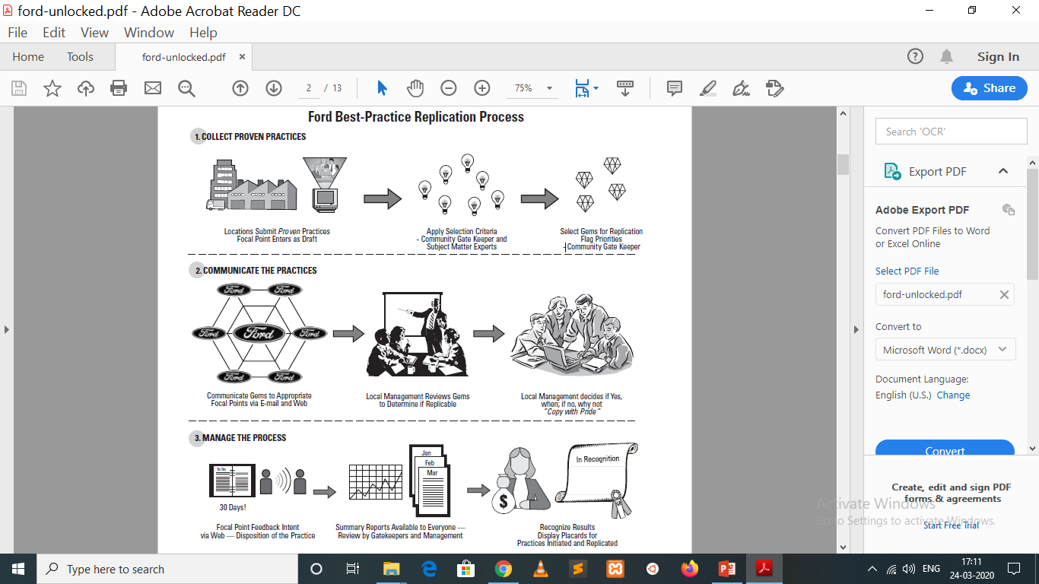
Ford Motor Company-BPR

Slide 8
More about Ford’s Best-Practice Replication
During the major recession in the late 1980s, Dale McKeehan, the general manager of vehicle operations at Ford, believed that in order to improve, the company needed to leverage and replicate the lessons of others.
He commissioned a team comprised of one person from every plant with the intent of driving productivity improvements based upon the proven successes of others.
He believed that transferring knowledge in this manner would lead to a better way of doing business.
During this time team members learned of certain process improvements in place in one plant were not necessarily used by others. These improvements, or best practices, were captured and shared with the other plants. This was the genesis of Ford’s Best-Practice Replication process.

Slide 9
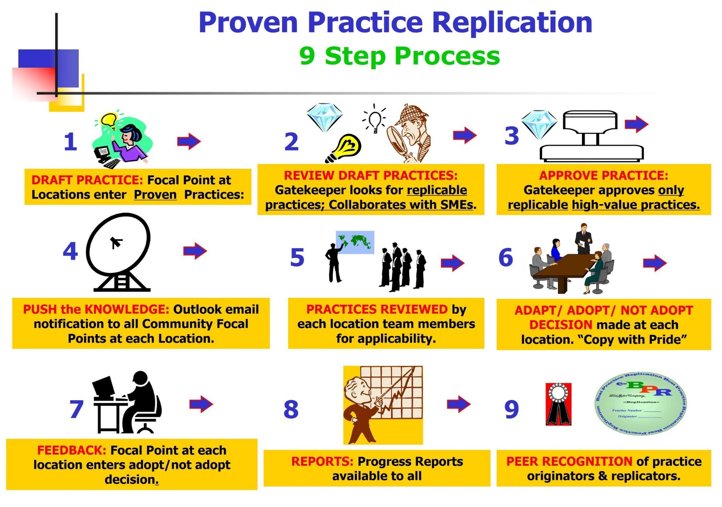
More about Ford’s Best-Practice Replication

Slide 10
More about Ford’s Best-Practice Replication
The next phase was to take this knowledge and deploy the team to actually help implement these best practices and at the same time capture the improvements that come with replication.
In time the original team evolved into a core group of four people, but the replication process continued.
The team continued to capture knowledge in a standard format known as a picture sheet and send it be mail, fax, and eventually email. The team collected feedback and maintained a matrix of which practices had been replicated and the cumulative value.
In 1995, with the advent of the Internet, Best-Practice Replication moved online. The Internet enabled automation of the communication by the first Web-based transactional database and application at Ford.

Slide 11

Knowledge Management Defined
Notes:
11

Slide 12
Knowledge Management Defined
According to Stan Kwiecien, a Best-Practice Replication deployment manager, knowledge cannot be managed. Instead, a company creates a culture and process to encourage people to share what they know.
The hard part is for employees to recognize that something they know is of value to others and to share it and to recognize that others know something of value to them and to copy and borrow it.
The knowledge management team at Ford believes that the process to share knowledge can be managed.
According to them, the core team should manage the information and the value and people will manage the knowledge.
Notes:
12

Slide 13

Business Objectives of the KM Program
Notes:
13

Slide 14
Business Objectives of the KM Program
The objectives of Ford’s knowledge management program are to create common, standard, and improved business processes. The knowledge management team strives to learn who is doing something better, share that with everyone else, and have them all use a best practice in support of the company’s key business strategies, which are safety, quality, delivery, cost, morale, and the environment.
In addition to the Best-Practice Replication process, which is based on communities of practice, other knowledge management initiatives at Ford have the common objective of collecting “best” information and knowledge within the company and making it available to people in other areas of the company who need it when they need it.
Ford’s intranet portal is designed to get people quickly directed to the sources of information and knowledge that they need when they need it.
Notes:
14

Slide 15
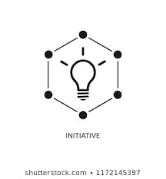


KM Initiatives, Activities and Services
Notes:
15

Slide 16
KM Initiatives, Activities and Services
The Best-Practice Replication process is Ford’s most mature knowledge management initiative.
A second, growing knowledge management initiative is knowledge-based engineering. It is best described as an interface between the CAD system and a database of knowledge about particular vehicle systems being designed.
If a design engineer violates a rule based upon knowledge of that system, then the CAD flags the area of concern and suggests proven alternatives. Any flags must be resolved as the design process continues.
Notes:
16

Slide 17


KM Initiatives, Activities and Services
Ford also has other, traditional knowledge management efforts with substantial repositories of data and information, with strict governance to maintain a high level of credibility and relevance
This governance is designed to ensure that the information is trustworthy and can be considered as knowledge.
Notes:
17

Slide 18


Organizational Structure
Notes:
18

Slide 19
Organizational Structure
Ford’s knowledge management program office resides in the IT organization. It crosses all activities and all components of the company.
The function of the knowledge management program office is to launch and shepherd new communities. The program office monitors community health.
If a community appears to be anemic, the program office will investigate and try to re-energize the community.
Within each community are focal points and gatekeepers. Focal points act as the community representatives for a particular location. The focal point may or may not be a decision maker and/or a subject matter expert.
Notes:
19

Slide 20

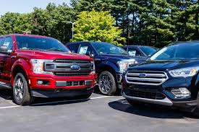
Organizational Structure
Notes:
20

Slide 21
Organizational Structure
The focal point is considered to be a conduit of knowledge. Their responsibilities include disseminating knowledge at their location and gathering and providing feedback to the authors. They act as a filter for content.
Gatekeepers act as community leaders and many are past focal points that have been promoted to the division level. It is important that both roles be well-defined in order to ensure people understand the responsibilities of both roles.
Gatekeepers are automatically notified of submissions to the Best-Practice Replication process. The gatekeeper then reviews the submission with the appropriate subject matter expert(s).
Notes:
21

Slide 22
Organizational Structure
The practice is then passed to the focal points who share it with the appropriate people within a location and begin the process of gaining buy-in for it. Managers primarily look at those practices not responded to by a location.
The program office drives both roles as deep into the organization as possible to ensure the participation and buy-in of that business.
Notes:
22

Slide 23

Core KM Products, Services and Offereings
Notes:
23

Slide 24
Core KM Products, Services and Offereings
The program office considers itself the shepherd of the Best-Practice Replication process and communities.
The real owners, according to program team members, are the business partners. IT provides the infrastructure. The program office team provides the application software and guidance to make sure the systems are launched and running well.
The program office also intersects with an IT activity called Collaborative Solutions.
If a business partner approaches the program office with a need for a knowledge management product and Best-Practice Replication is not the solution, then the office recommends a more appropriate knowledge management solution, whether that is a repository, a portal gadget, or some other existing or planned offering
Notes:
24

Slide 25



Funding
Notes:
25

Slide 26
Funding
Aside from the small group in the knowledge management program office, there are no positions fully devoted to Best-Practice Replication.
Aside from the budgeting for the database, the Web developer, and program office support, there is no specific funding for knowledge management at Ford. But businesses realize there is value by participating.
According to Kwiecien, through the 50-plus communities, the program office supports approximately 25 vice presidents’ areas. It is recognized that Best-Practice Replication adds value to the enterprise and is included as a line item in the annual IT budget. Custom development is charged on a time and materials basis to business partners.
Notes:
26

Slide 27
Funding
In addition, the program office licenses the Best-Practice Replication process to external organizations.
Participants, as of 2003, are Shell Oil, Nabisco, Kraft Foods, and the U.S. Navy Aircraft Carrier Team One Maintenance group.
In this way, Best-Practice Replication pays for itself. It is one of the few applications in the entire company that funds itself in this manner.
Notes:
27

Slide 28
KM Activity Overview
Ford’s knowledge management activities are quite broad.
The following slides provide an overview of communities of practice, facilitated best practices transfers, expertise locator systems, decision support systems, lessons learned, content management, and After-Action Reviews within the company.
Notes:
28

Slide 29
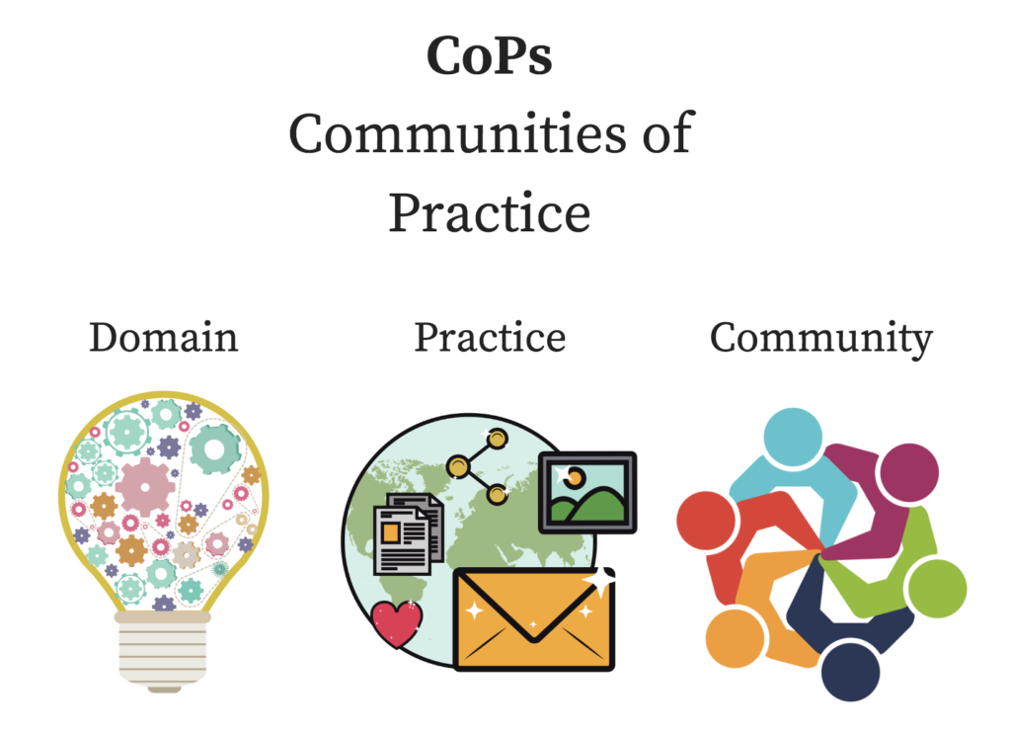
Communities of Practice
Notes:
29

Slide 30
Communities of Practice
Ford has a mature community of practice structure and Best-Practice Replication process. At Ford, the communities of practice are naturally occurring groups of people who perform similar work and are geographically dispersed.
Each community of practice is made up of focal points who represent the community at each location. A gatekeeper administers each community.
Based on experience, the program office believes that 40 to 50 locations per community are optimal for a gatekeeper or focal point.
Notes:
30

Slide 31
Communities of Practice
The communities of practice operate independently, with the Best-Practice Replication program office acting in an advisory capacity to support the communities of practice.
Currently there are more than 50 active communities of practice at Ford. Only 15 are manufacturing related, and the rest are located in support areas such as human resources; material, planning, and logistics; product development; IT; and finance.
Notes:
31

Slide 32

Transfer of Best Practices
Notes:
32

Slide 33
Transfer of Best Practices
Best-Practice Replication is a push process with defined roles and responsibilities.
Using Best-Practice Replication, communities share proven practices that have made an improvement to a business process, not ideas.
The advent of Web-based technology enabled the process to be largely automated in 1996. These practices are shared through picture sheets, video clips, and documentation.
The key to success was measuring the value of the knowledge transfer and the resulting replications.
Notes:
33

Slide 34

Expertise Locator System
Notes:
34

Slide 35
Expertise Locator System
At this time, Ford does not have an expertise locator system. Each major organization has lists of experts, usually accessible from their home page.
Depending on the organization, some do have details about the person’s experiences and expertise. This is especially prevalent in the research and product development organizations.
The enterprise portal has links to organization charts to help identify positions. The enterprise “People Search” is a common directory of every employee with e-mail access. This directory does describe the job functions.
Ford does intend to implement an enterprise-wide expertise locator system.
Notes:
35

Slide 36

Decision Support Systems
Notes:
36

Slide 37
Decision Support Systems
Ford has many decision support systems; most are driven by the finance and quality analysts. It also views knowledge-based engineering as a type of decision support system.
Six Sigma includes some refined decision support systems as tools to aid Black Belts in analyzing data and suggesting where to focus Six Sigma efforts.
Each major organization in Ford has its own derivatives designed to suit their business needs.
Each are funded and maintained by the respective IT support for that organization.
Notes:
37

Slide 38

Lessons Learned
Notes:
38

Slide 39
Lessons Learned
In addition to the lessons captured in the Best-Practice Replication process, a lessons learned repository was created in 1997 at Ford with the intent of allowing anyone to submit or retrieve a lesson learned.
Interpretations of lessons learned were entered without any governance; the result was that few could be accurately retrieved. The lessons learned database was deactivated in 2001.
Currently, “powertrain” operations has developed and is expanding a process called the preventive corrective action system, where a lesson learned is defined as “a corrective action that has been effectively closed, can be replicated, and is fed back into Ford’s quality operating system to ensure permanent change.”
Notes:
39

Slide 40

Content Management
Notes:
40

Slide 41
Content Management
According to Kwiecien, a lack of content is one reason that duplication of effort or mistakes happen. Therefore, at Ford, content management is a well-defined process for any documentation that is ultimately searchable on its intranet.
A strict governance and review process guides anyone who needs to post to the central repository, or enterprise knowledge base.
Each posting is reviewed for adherence to the governance guidelines and for possible duplication. Document retention policies apply.
Only properly registered documents with appropriate taxonomies are searchable by the corporate search engine.
Notes:
41

Slide 42
Content Management
The actual content is the responsibility of the posting organization.
There is a charge associated with the posting that in effect funds the enterprise knowledge base content management process. The cost varies with the volume of activity.
Content management is the responsibility of the gatekeepers in each community.
The Best-Practice Replication process has three filter stages for content.
Notes:
42

Slide 43

After-Action Reviews
Notes:
43

Slide 44
After-Action Reviews
After-Action Reviews are routinely held during the course of any major project. For example, the product development function uses the Ford product development system with milestones at key timing dates.
The decision to advance to the next milestone requires reflection concerning if the goals have been met and what went well or what went wrong.
Similarly, during the launch of a new or revised product or service, After-Action Reviews are often held daily with a major review (launch critique) after completion of the launch or project.
If necessary, lessons learned during this process are brought back into the operating system to ensure change.
Notes:
44

Slide 45
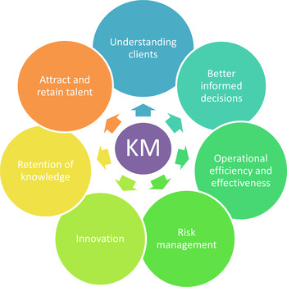
Measuring KM
Notes:
45

Slide 46
Measuring KM
Ford’s knowledge management program office does not launch a community of practice if it can not measure improvement. Everybody who does work, regardless of what organization it is in, has to have some metric that indicates how they are improving the business.
Most communities state savings as percentage improved, customer satisfaction indicators, accident rate reduction, and cycle time improvements.
The program office knows these could be converted into dollars; however, it concentrates on showing the value to the users in their own metrics, which may not be expressed financially.
These improvements ultimately cascade and translate as overall improvement to the bottom line.
Notes:
46

Slide 47
Measuring KM
Some hard dollar savings are obvious, such as those that come from energy reduction, material savings, labor savings, or throughput increases; and the program office does capture these.
With the value of replication in both the soft values and the hard dollars, there is enough bottom-line value to continue pursuing better ways of doing business through the Best-Practice Replication process.
Depending on the community, practitioners and users have a variety of ways to express value.
The point is that each community measures their improvement, in their own metrics and in their own language. The practitioners want and need to see value in their own terms.
Notes:
47

Slide 48
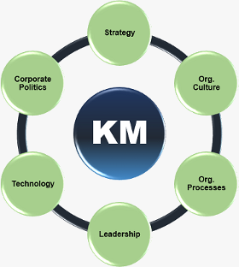
KM Measures
Notes:
48

Slide 49
KM Measures
Each community of practice picks its own measures, and in many cases, these measures are unique to that community of practice. They develop or use measures applicable to their business.
During the process of developing a community of practice, one important step is to determine the measures and metrics.
The focal point in each community of practice is responsible for collecting measures. And, in each picture sheet, there is a field to report the value of the improvement. In some communities, it is mandatory to complete this field.
If they do not replicate the practice, then they must explain why. If so, they must explain the value to them.
Notes:
49

Slide 50
KM Measures
In the case of communities of practice, the measures are important to making the decisions to replicate. The replicating site can relate to what the originator saved or improved and can identify benefits.
The program office encourages each community to leverage activities it already does for measurement not to invent new things to be measured on.
For knowledge management to succeed, there needs to exist trust, relationships and an indicator of value. What the knowledge management program office encourages is a sense of obligation to share something of value, which in this case a means to improve a day-to-day process. People need to understand and trust the values described by the measures.
Notes:
50

Slide 51
KM Measures
Because many measures are specific to a community of practice, generic measures are not included. Metrics tend to be dynamic and evolve as the community of practice matures.
In most communities of practice, there are a select, few measures that are relevant to the community members.
Therefore, determining which ones are the most successful depends on the community. The stakeholders are the ones who support the Best-Practice Replication process.
The program office has learned that there needs to be some measure of dollars in each community of practice to satisfy the stakeholders, even if the majority of the real measures may not be fully quantifiable.
Notes:
51

Slide 52
KM Measures
The stakeholders typically have higher level key indicators. Measures are reported at the plant and executive levels.
For Best-Practice Replication, the number of replications is the most valuable measure because senior leadership can recognize if employees are using the process.
Additionally, in the picture sheets, leaders can see both the hard and soft value of the replications.
Notes:
52

Slide 53

Benefits of KM
Notes:
53

Slide 54
Benefits of KM
Although Best-Practice Replication was developed and is used primarily to drive improvement in manufacturing and business support activities, one of the most significant improvements has been to the safety of Ford’s employees with a derivative called global preliminary incident reporting.
The Best-Practice Replication process immediately communicates these to the more than 700 safety engineers globally as an alert to be aware of any conditions that led to the incident or near miss.
A subset of these becomes an immediate corrective action, where the safety engineers are required to confirm compliance to the actions described.
Notes:
54

Slide 55
Benefits of KM
In 1998 Ford’s Occupational Health and Safety office measured that for every 200,000 hours worked there was an average of 7.4 accidents that resulted in lost time.
In 2002 the average was 1.9 accidents. This is a significant benefit measurable by a very specific industry-wide metric.
Use of Best-Practice Replication was not the sole reason for improvement, but it was certainly an enabler and contributor through awareness and replication of corrective actions.
Notes:
55

Slide 56

Making the Business Case
Notes:
56

Slide 57
Making the Business Case
In the case of Best-Practice Replication, there was no business case needed for its development. The value and long-term benefits were visualized in the minds of visionary leadership, and their expectations were communicated to those charged with implementation.
In the case of other knowledge management initiatives, leadership provides the vision, assembles a team to investigate, and provides the budget based upon the team’s implementation proposal.
The IT budget has discretionary funding available for future knowledge management initiatives.
Notes:
57

Slide 58
Making the Business Case
Evidence for knowledge management substantiation most often comes from a survey of the potential users with estimates of time saved through the use of knowledge management initiatives as the value.
For example, a survey of product development engineers in the late 1990s found that engineers were spending approximately 25 percent of their time looking for information and finding only about 10 percent of what they needed.
These survey results served as the genesis for knowledge-based engineering, which in turn made the engineers more productive.
Notes:
58

Slide 59
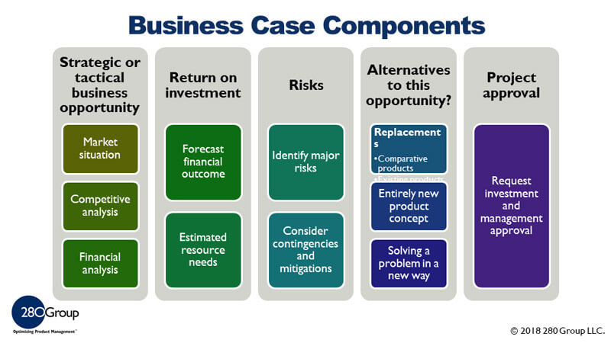
Compelling components of the Business Case
Notes:
59

Slide 60
Compelling components of the Business Case
In the case of Best-Practice Replication, the value provided year after year is compelling to leadership. Enlightened leadership understands the intangible yet valuable benefits of knowledge management.
Over the years, the program office has observed the number of communities grow as seasoned managers with community experience move around the organization to areas that do not have communities.
It is the responsibility of the investigating teams to determine if a request is a knowledge management initiative or simply a repository or business process automation project.
Notes:
60

Slide 61
Compelling components of the Business Case
Business process automation projects do require a stringent business case and ROI calculation.
If a business case were required for other knowledge management initiatives, then the most compelling components might be survey results from the persons who would indicate the potential value and results from a knowledge management initiative pilot of the conducted without any technology investments.
The least compelling components would be fabricated and inflated savings expressed in dollars and statements like: “This is the way ABC company does it, and we need to do the same.”
Notes:
61

Slide 62

Managing Stakeholder Expectations
Notes:
62

Slide 63
Managing Stakeholder Expectations
At Ford, the stakeholders tend to be general managers or directors; they are rarely found at the middle management level. These stakeholders set the expectations and provide the budget and the resources for knowledge management activities.
A properly designed and implemented knowledge management initiative has the stakeholders’ involvement in the planning, in the initial implementation, and in periodically reviewing the results.
If a stakeholder changes, it is the job of the program office to find a new stakeholder and bring that person on board.
It is important that results are reviewed with the stakeholders frequently at the onset. Over time the frequency of predetermined intervals can diminish.
Notes:
63

Slide 64
Managing Stakeholder Expectations
If there are no results to review, the knowledge management initiative is not adding value and should be revised or stopped.
A failed knowledge management initiative almost ensures that future attempts will meet resistance, so it is important not to fail in the beginning.
The cost of travel in the initial investigation of the Best-Practice Replication process was unanticipated, the benefits of it were the personal relationships that developed within the communities of practice and the recognition that this process does add value.
The team felt an obligation to make Best-Practice Replication work and deliver value because they were instrumental in developing the process.
Notes:
64

Slide 65

KM Results
Notes:
65

Slide 66
KM Results
In banner years, the Best-Practice Replication process has delivered approximately $200 million in annual value since 1995, and Ford has documented approximately $1 billion of hard value from 1995 to 2002.
Notes:
66

Slide 67



Investments, Results and Drivers of Success
Notes:
67

Slide 68
Investments, Results and Drivers of Success
For the knowledge management program office, the two main drivers of metrics are to expand the program’s presence throughout the company and create an environment that will increase its value to the business over the years.
Best-Practice Replication costs no more than $500,000 annually to administer and support. The investment required of the community of practice members is their time and travel.
Travel and meeting costs are estimated at $500 thousand annually. These costs are concurrent with other businessneeds to travel and meet and are not specific to Best-Practice Replication.
Notes:
68

Slide 69
Investments, Results and Drivers of Success
Additionally, using and sharing knowledge shows up on the annual performance reviews for the focal points and gatekeepers within each community. This step was taken to increase the penetration of best practices and further develop the environment to drive participation.
The program office considers the values reported by Best-Practice Replication, in addition to the hard savings, to be a barometer rather than hard savings. Each organization has specific means to officially capture the actual financial impact.
Additionally, in an attempt to link the value of the activity to Ford’s performance measurement system, the role of focal point and gatekeeper are now part of formal job descriptions, so people in those roles are measured against it.
Notes:
69

Slide 70
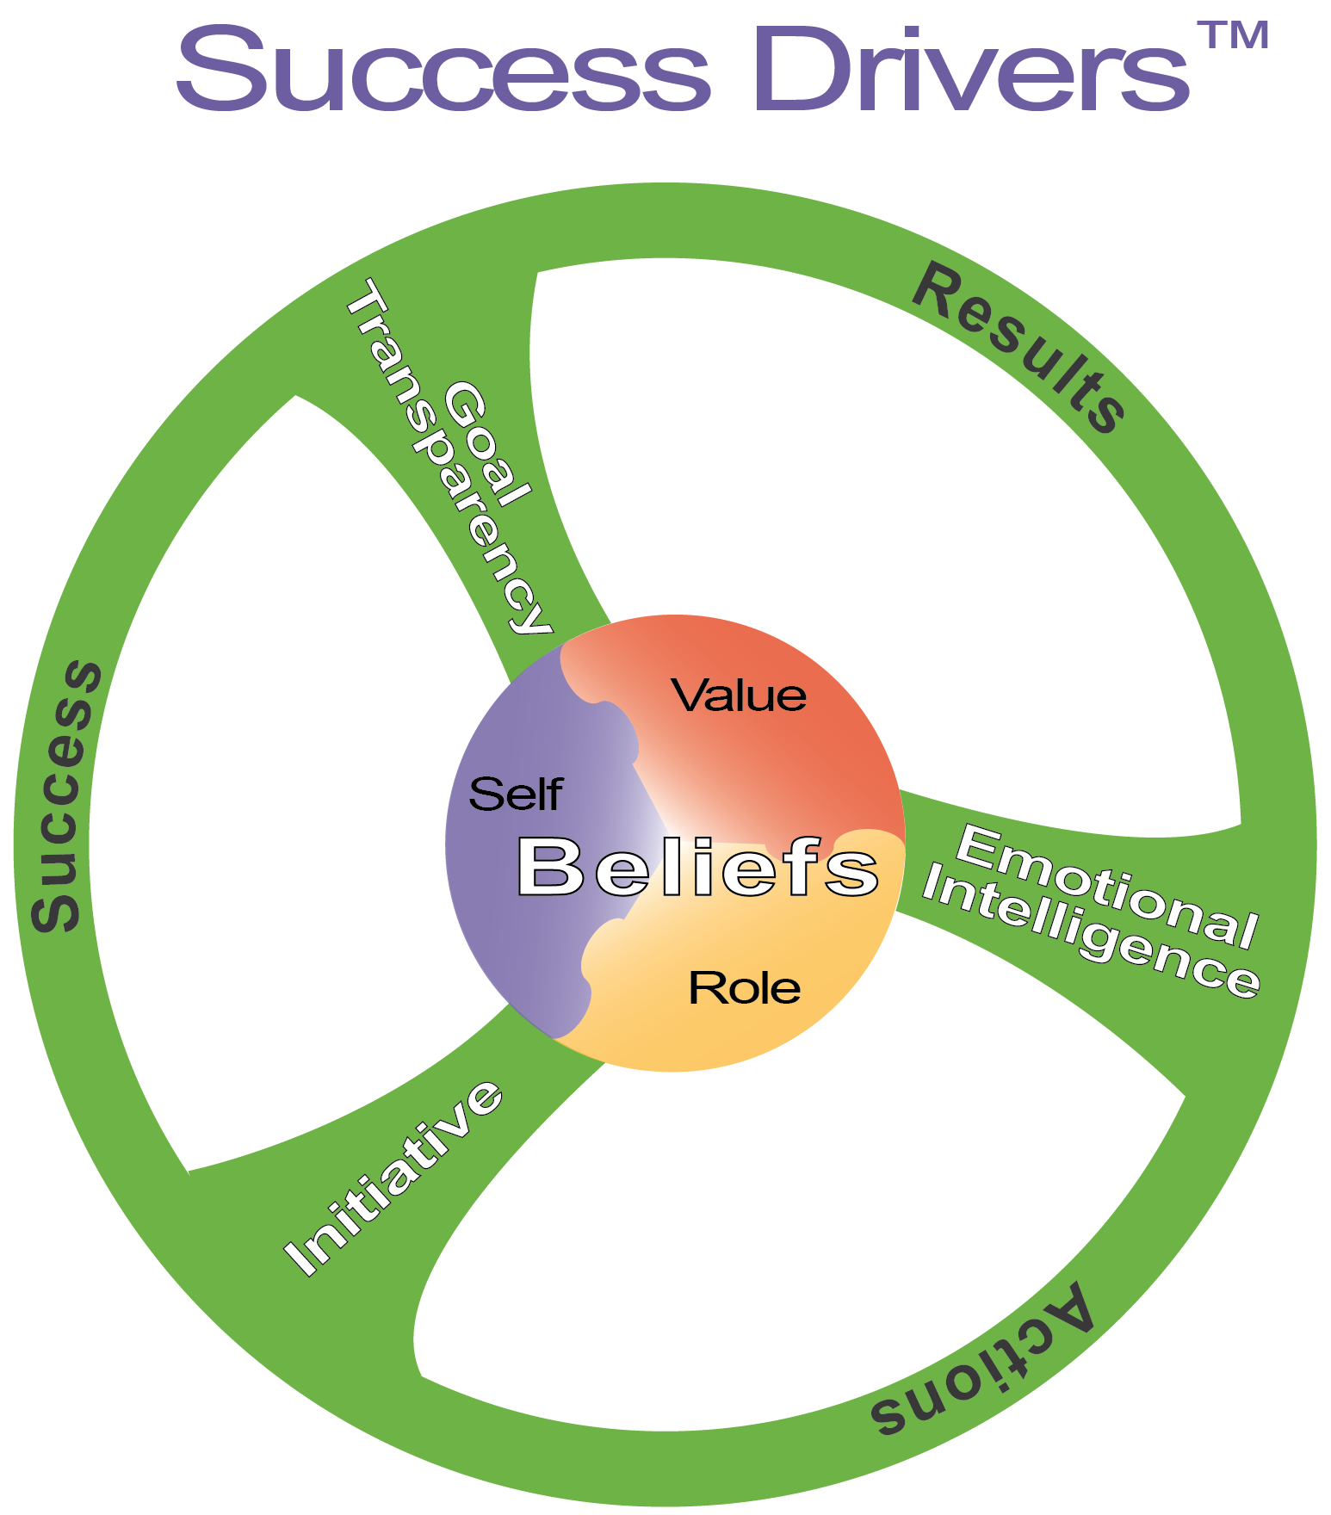
Modules
Notes:
70

Slide 71
Drivers of KM Success
Everyone is busy. But if a knowledge management initiative adds value to day to-day work, then it will be used to improve both daily and future work practices.
The predictors and drivers are the same for any knowledge management initiative:
the willingness and passion to share and re-use knowledge. Nourishing this type of culture requires the leadership of senior management.
The message needs to be that the company needs invention and innovation to improve, and it should leverage the work and experience of others as the starting point.
Notes:
71

Slide 72
Drivers of KM Success
Peer recognition and a sense of healthy competition are also important factors.
The design of the knowledge management initiative must have clear business related objectives.
The key differentiator between those who achieve results and those who do not is passion, according to Kwiecien.
A community of practice will thrive if its culture is one that exhibits a passion for sharing and helping, passion for knowledge, and passion for improvement.
People in the program office and in the gatekeeper and focal point roles all need to show a passion for sharing.
Notes:
72

Slide 73

Success Stories
Notes:
73

Slide 74
First Success
The first story comes from the material planning and logistics community, where a forklift operator at the Norfolk Assembly Plant whose job was to transfer stacks of truck frames from a rail car to the production area thought that there was enough space on the railcar to accommodate five stacks instead of the usual four.
Trials were conducted, and his idea was proven. The net result was a multimillion dollar annual freight cost savings. Because the railcars belong to the railroad, they performed the conversions and Ford shared the freight cost benefit.
Although the original success involved one type of frame, the concept was expanded to all frames delivered by rail and to other bulky components as well, thus multiplying the net effect. The forklift operator received the maximum award as allowed by the suggestion program.
Notes:
74

Slide 75
Second Success
The second success comes from Ford’s energy community. A plant in the Midwest was investigating the benefits of replacing up to 40 individual air houses on the roof with one BigFoot unit.
The method used by Ford to calculate the ROI for this type of project would not support the investment. The supplier of the BigFoot proposed to install the unit at his expense and in return be paid a percentage of the resulting savings over the next 10 years.
Five plants now have BigFoot units, and more are planned. Savings to Ford will be in the millions of dollars per year for the duration of the contract and significantly more after expiration.
Notes:
75

Slide 76
Third Success
The third success story shared by Ford originated in a product development community of practice.
In this community, one of the members developed a mathematical model that associated design variables and features with known customer expectations, likes, and dislikes.
This predictor model has been replicated across all vehicle platforms, and the rule is included within knowledge-based engineering.
Notes:
76

Slide 77


Looking Forward
Notes:
77

Slide 78
Looking Forward
Measurement must by an integral part of the knowledge management process.
When establishing a community of practice, determining the measures and metrics is critical.
These must be relevant to the work performed by the community of practice and be a trusted means of measurement readily recognized by members of the community of practice.
Inherent in that is the supposition that the community showsvalue to the business.
The community of practice stakeholder or sponsor must be recognized and respected and value the measures used by the community of practice.
Notes:
78

Slide 79
Looking Forward
Stakeholders need to monitor community health and see community results.
The activity of the community of practice must focus on and address business needs.
Finally, the technology must support the collection and reporting measures within the same space used by the community of practice.
It needs to be easy as well. A manager should be able to access a report within three clicks.
Notes:
79

Slide 80
Thank You

